Slide 1
Let’s Learn MCP Model Context Protocol
Season of AI
Elbriner Da Silva
Fernando Gómez
Notes:
Speaker Introduction

Slide 2
Agenda
¿Qué es MCP? ¿Cómo funciona? ¿Cómo se usa?
Descripción detallada de las funciones de MCP
Construyendo un servidor MCP
https://aka.ms/letslearnmcp-csharp

Slide 3


¿Que es MCPs?
MCP: El puente entre IA y aplicaciones reales
MCP (Model Context Protocol) es un protocolo innovador que permite que modelos de IA interactúen de manera fluida con herramientas y datos externos, expandiendo sus capacidades más allá del conocimiento preentrenado.
Desarrollado por Anthropic, MCP establece un estándar abierto para conectar sistemas de IA con aplicaciones reales como bases de datos, APIs, IDEs y servicios empresariales.

Slide 4

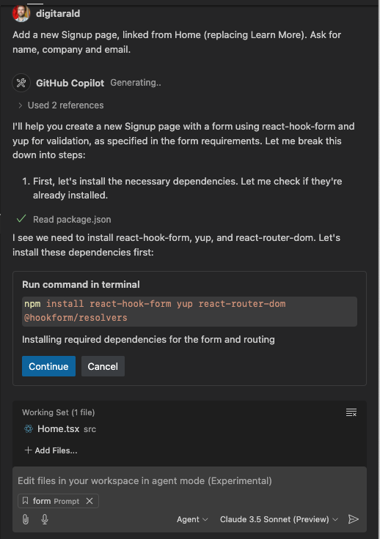
¿Pero cómo proporcionamos contexto en tiempo real? ¿Cómo nos conectamos a nuestra base de datos? ¿Consultar los problemas de GitHub? ¿Ejecutar pruebas con lenguaje natural? ¿Cómo podemos cerrar las brechas entre nuestro código, el cliente y el LLM, y todo lo demás?
Agent mode
Programación con agentes
Acelera la entrega pasando del código a los resultados
Programador en pareja autónomo de IA que planifica, ejecuta e itera en tareas de codificación de múltiples pasos, desde el editor hasta la terminal, y de las pruebas al depurador

Slide 5

Beneficios clave de usar MCP
Desacoplamiento inteligente
Separa modelos IA de integraciones específicas, facilitando la reutilización y mantenimiento de código en múltiples proyectos
Acceso seguro en tiempo real
Permite acceso controlado y seguro a datos y funciones externas sin comprometer la arquitectura de tus sistemas
Integración simplificada
Facilita la conexión con múltiples clientes y modelos sin necesidad de programar APIs personalizadas para cada caso

Slide 6

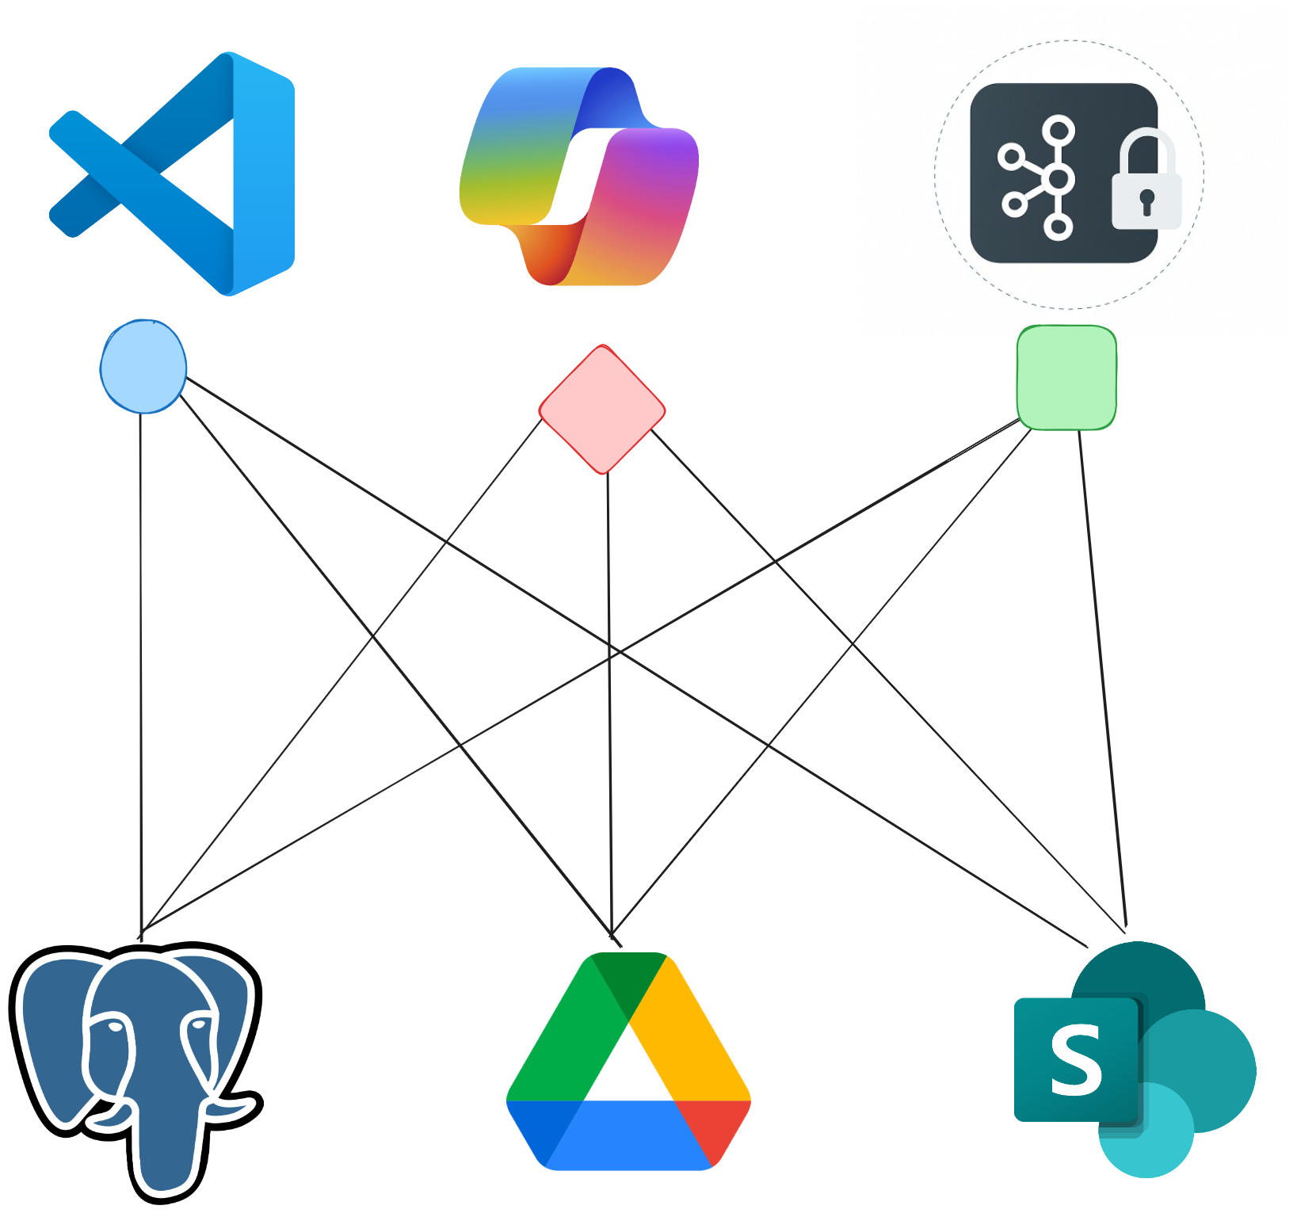
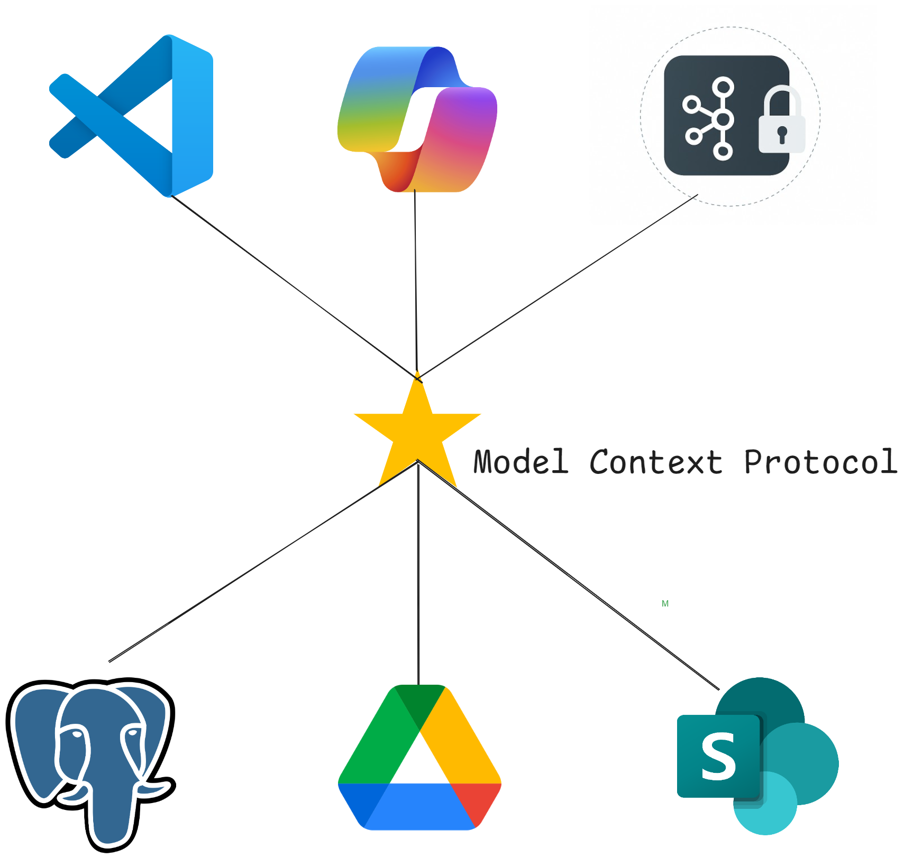
The need for MCP arises – a Timeline
Las herramientas son fundamentales para el rendimiento del agente
Integración del chaos!!!
La necesidad de un estándar (MCP)

Slide 7
MCP is an open protocol that standardizes how applications provide context to LLMs. It’s like USB-C but for AI
Notes:
MCP servers provide a standard way, or protocol, to connect LLMs with data, tools, and resources. The MCP website describes MCP as a universal adaptor for AI applications. In the same way that a universal adaptor lets you connect your physical devices to accessories, MCP lets you connect AI applications to other data and tools without needing to build a custom connection to each data source.

Slide 8
Model Context Protocol Created by Anthropic Adopted by the AI community Evolving Together
Notes:
The important thing to remember is that Model Context Protocol is adapting and evolving as AI changes. It was created by Anthropic and has been adopted as a standard throughout the AI community.

Slide 9
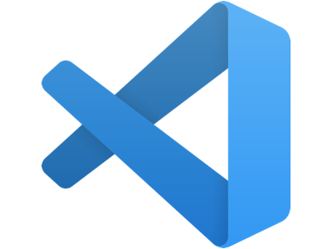
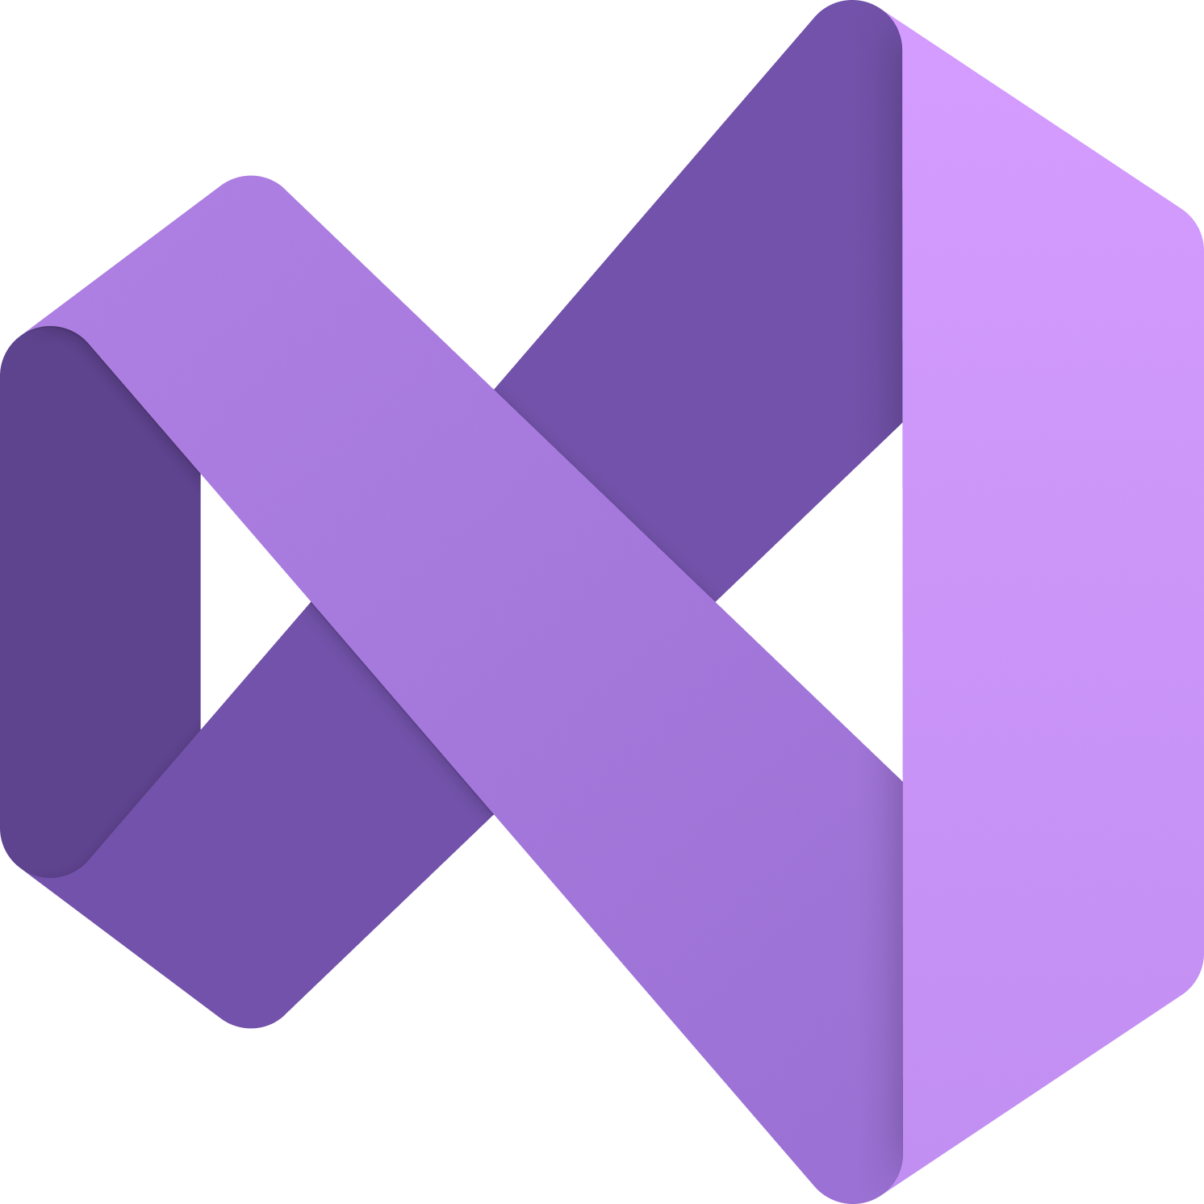



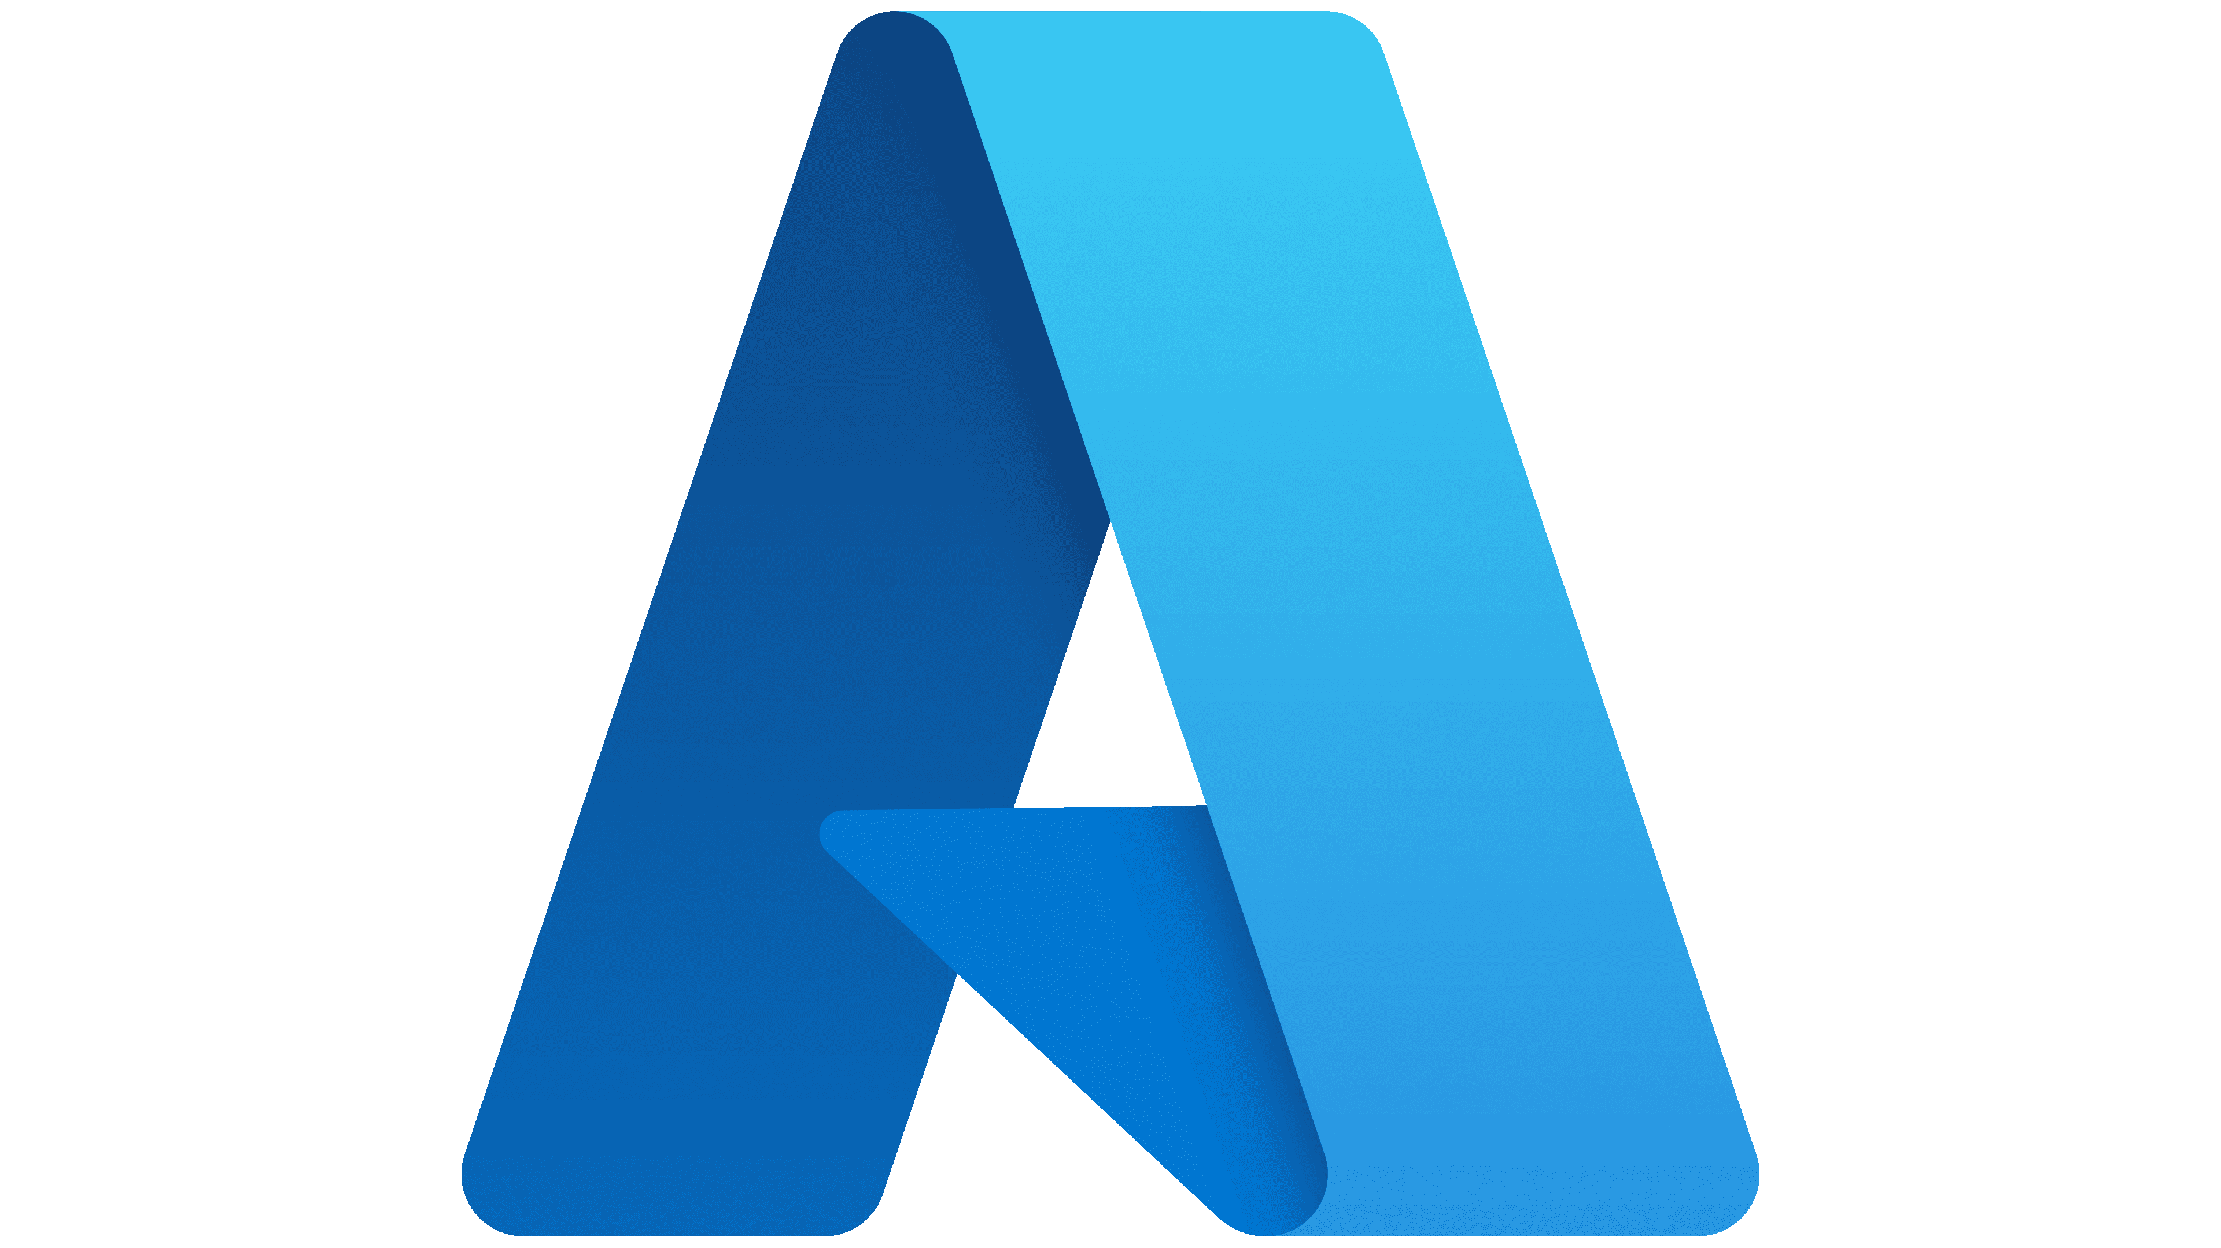




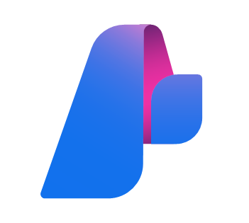

Partes of MCP
Hosts
Clientes
Servers

Slide 10
Demo
SPEAKER PREP: Choose the best link for your audience
Setting up & using MCP servers aka.ms/letslearnmcp-csharp
aka.ms/letslearnmcp-java
aka.ms/letslearnmcp-python
aka.ms/letslearnmcp-javascript
Notes:
let’s take a look.

Slide 11
MCP Deep-Dive Adapted from Mahesh Murag (Anthropic) AI Engineer session
MCP Client
Invoca Tools
pide Resources
Interpola Prompts
MCP Server
Expone Tools
Expone Resources
Expone Prompts
Tools
Model-controlled
Funciones a las que invoca el modelo
Resources
Application-controlled
Datos expuesto a la aplicación
Prompts
User-controlled
Plantillas prdefinidas para integración con IAs
Retrieve / search
Files
Document Q&A
Send a message
Database records
Transcript Summary
Update DB records
API Responses
Output as JSON
Notes:
To recap what we have done so far is created a new project, saw how we can integrate in the GitHub MCP server to query, create, and update issues on GitHub, directly from VS code. We also connected to a data source, in this case the Monkey MCP that exposed different data about the monkeys that we then used to help us craft our application.
[click]
Everything that we used was one of the features of MCPs called Tools. Think of them as functions that the LLMs can invoke to perform actions or get data.
[click]
But, there is more to MCP servers than just tools, including resources and prompts. So let’s go a bit deeper.

Slide 12
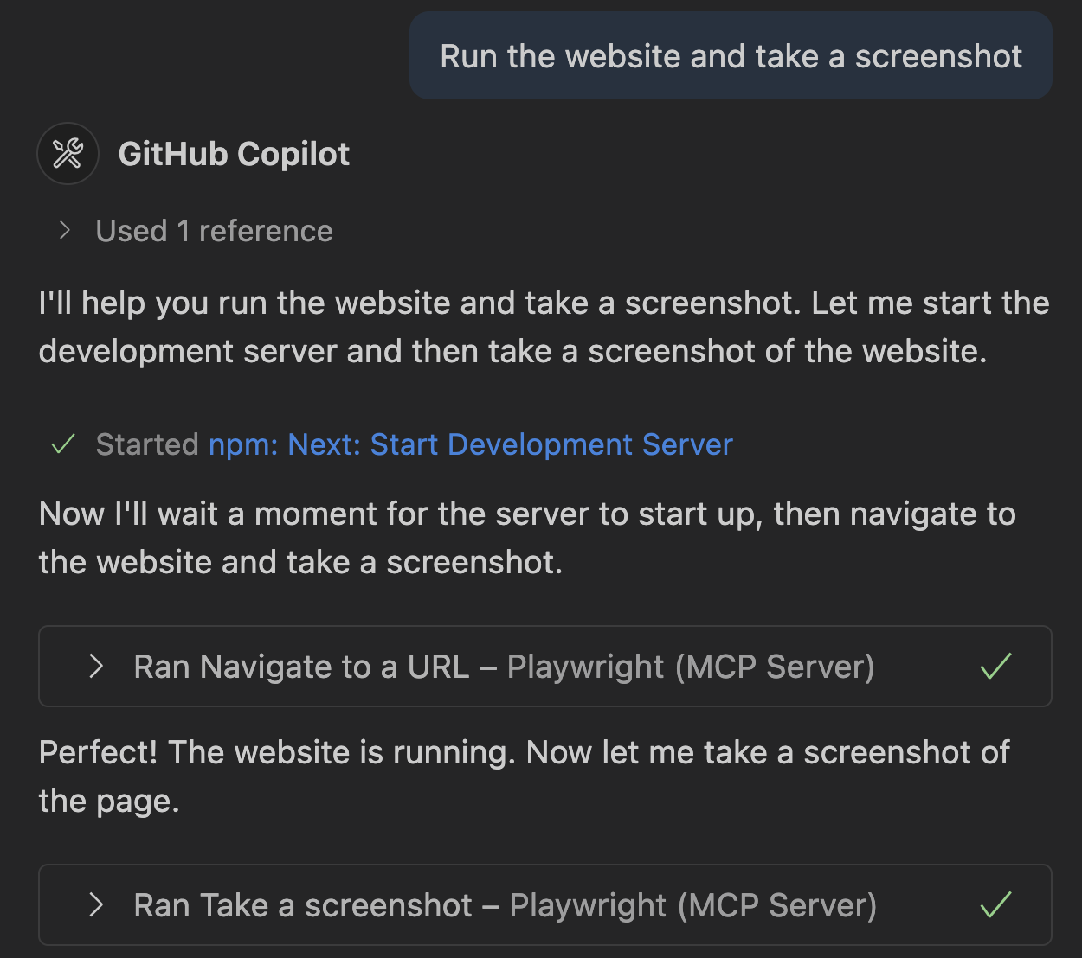
Tools
Primitivas básicas mas comunes
Funciones que los LLM pueden llamar para realizar acciones específicas, básicamente llamada de funciones.
Envío de email
Actualiza “TO-DOs”
corre tests
Documentar bugs
Notes:
Alright tools, as I mentioned and what we saw, are the core of MCP servers today. They allow you to get data, update data, or perform actions. What James showed was the ability to get data and also perform actions on GitHub. But there are a lot of use cases to stay in the flow including accessing your smart home, music services, or more. And of course there are a lot of developer focused MCPs, such as the Playwright MCP, you see here which allows you to navigate and explore your website through natural language.

Slide 13
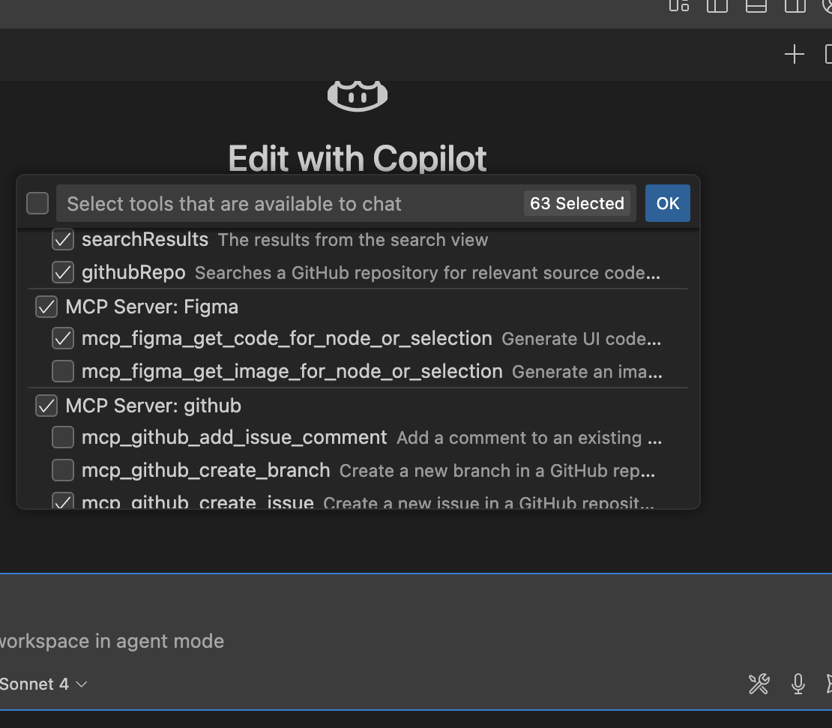
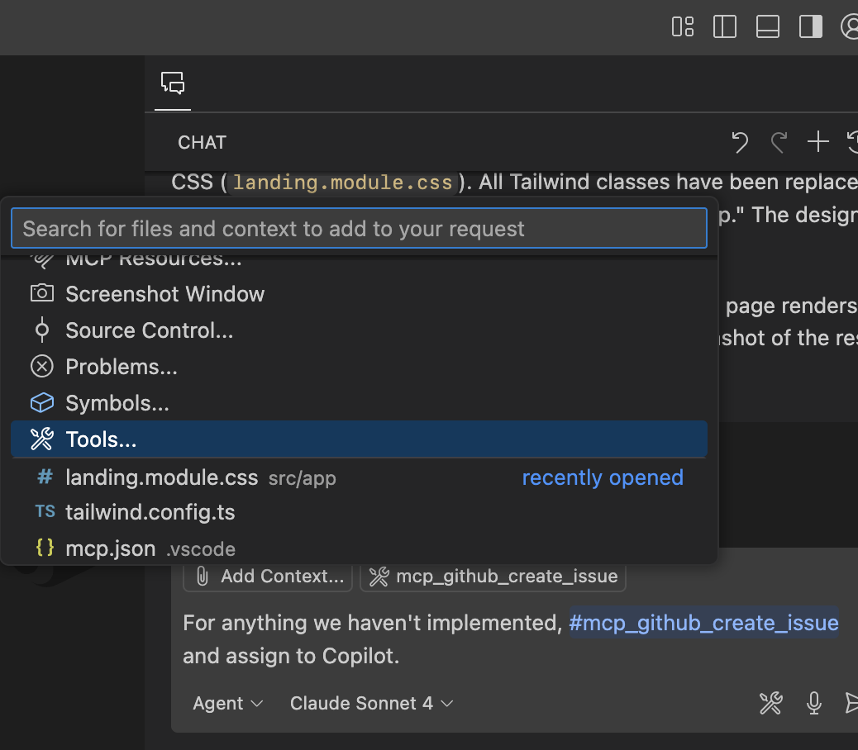
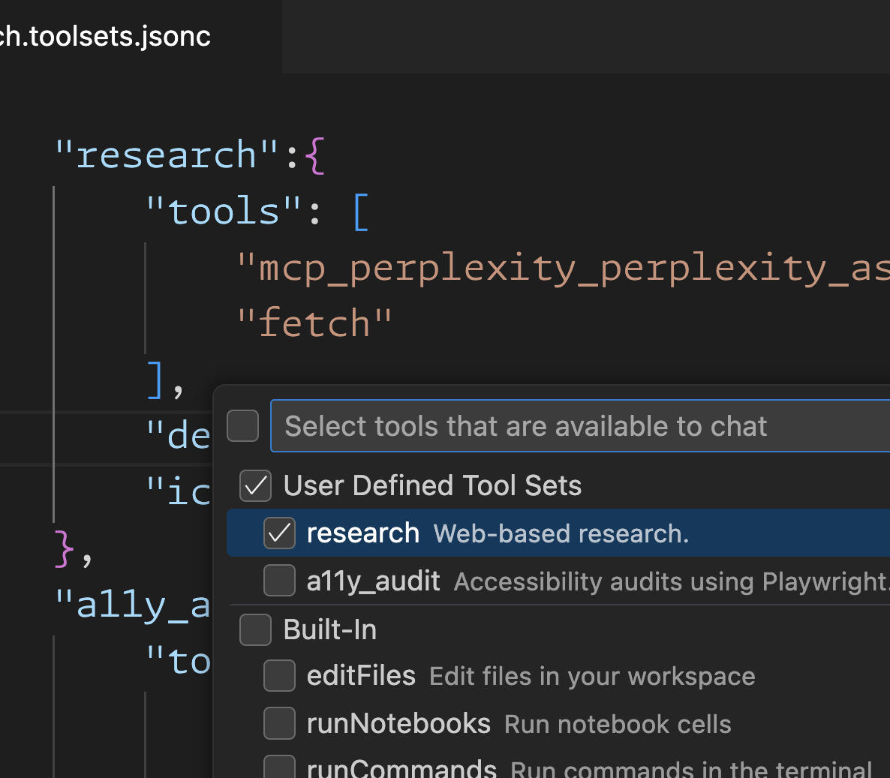
Tools: User controls
Provide user controls to fine-tune and improve tool calls
Selección de herramienta chat
nombra herramientas en las indicaciones
Conjuntos de herramientas definidos por el usuario
Reducir manualmente las herramientas necesarias para completar una tarea específica
Reduce las conjeturas y utilice las herramientas de referencia según sea necesario.
Reutilizar herramientas específicas de la tarea en diferentes tareas
Notes:
You have a lot of control over the tools available. You can configure them per project or system wide. You can also select directly which ones you want to use when making a chat request, you can use them in prompts directly, and you can even define tool sets that you can re-use across tasks. For example you may have a “research” set or a “coding” set of tools so you can easily jump between them based on what you are trying to accomplish.

Slide 14
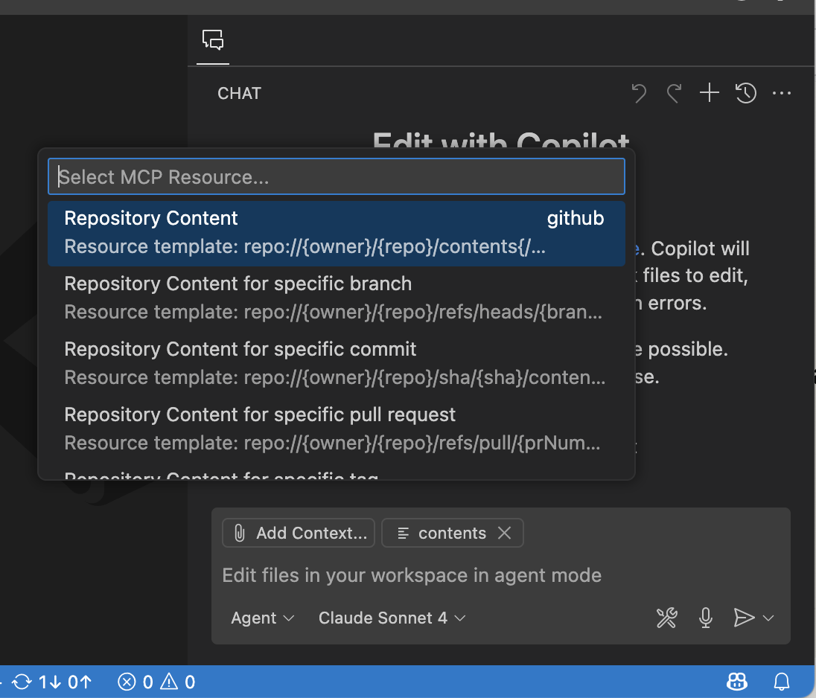
Resources
Facilidad para añadir y devolver datos
Exponer datos de manera de solo lectura como URIs para cliente/agente/usuario.
Ficheros
Documetnos
Database entradas/schemas
Imagenes
Notes:
The Model Context Protocol (MCP) provides a standardized way for servers to expose resources to clients. Resources allow servers to share data that provides context to language models, such as files, database schemas, or application-specific information. Each resource is uniquely identified by a URI.
Resources in MCP are designed to be application-driven, with host applications determining how to incorporate context based on their needs.
For example, here the GitHub MCP server exploses repository content directly through a URL that you can fill in and then attach as context to a request.

Slide 15
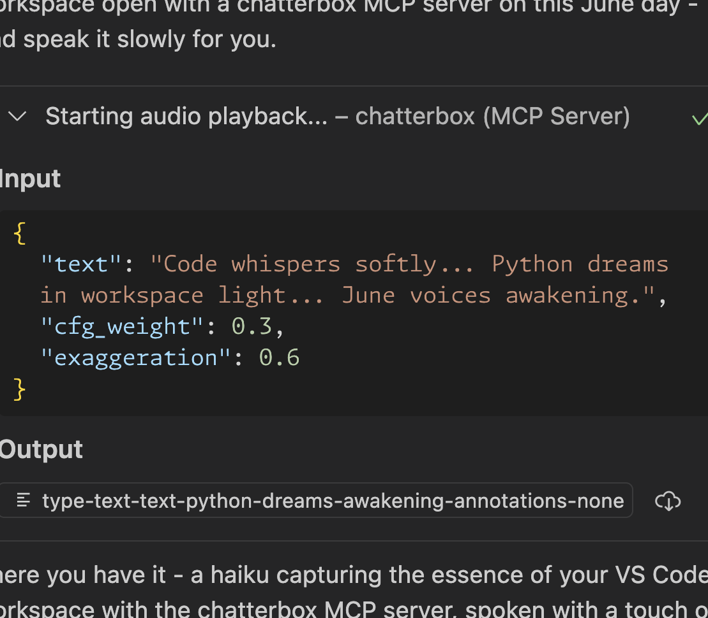
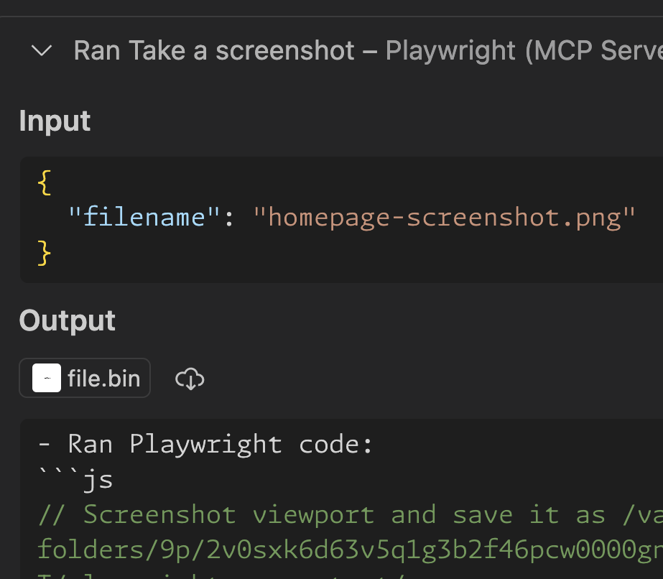
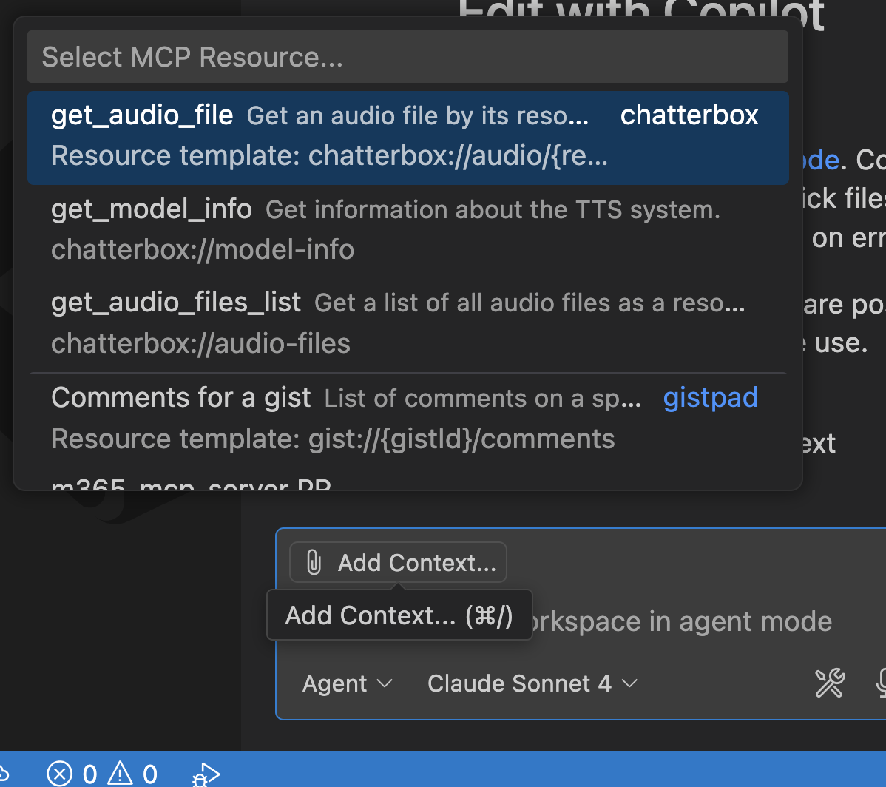
Resources: Use cases
Hacer que los datos sean accesibles para clientes y usuarios
Reducir los tokens de respuesta
Adjuntar como contexto
Exponer datos/archivos al usuario
Devolver recursos incrustados permite que el agente obtenga los datos.
Proporcione activos para que el usuario actúe sobre ellos, no el contexto del LLM.
Reduciendo las búsquedas de herramientas con recursos específicos adjuntos.
Notes:
What is nice is that you can easily give the agent data directly so it doesn’t have to go fetch it, you can provide data back and attach it.

Slide 16
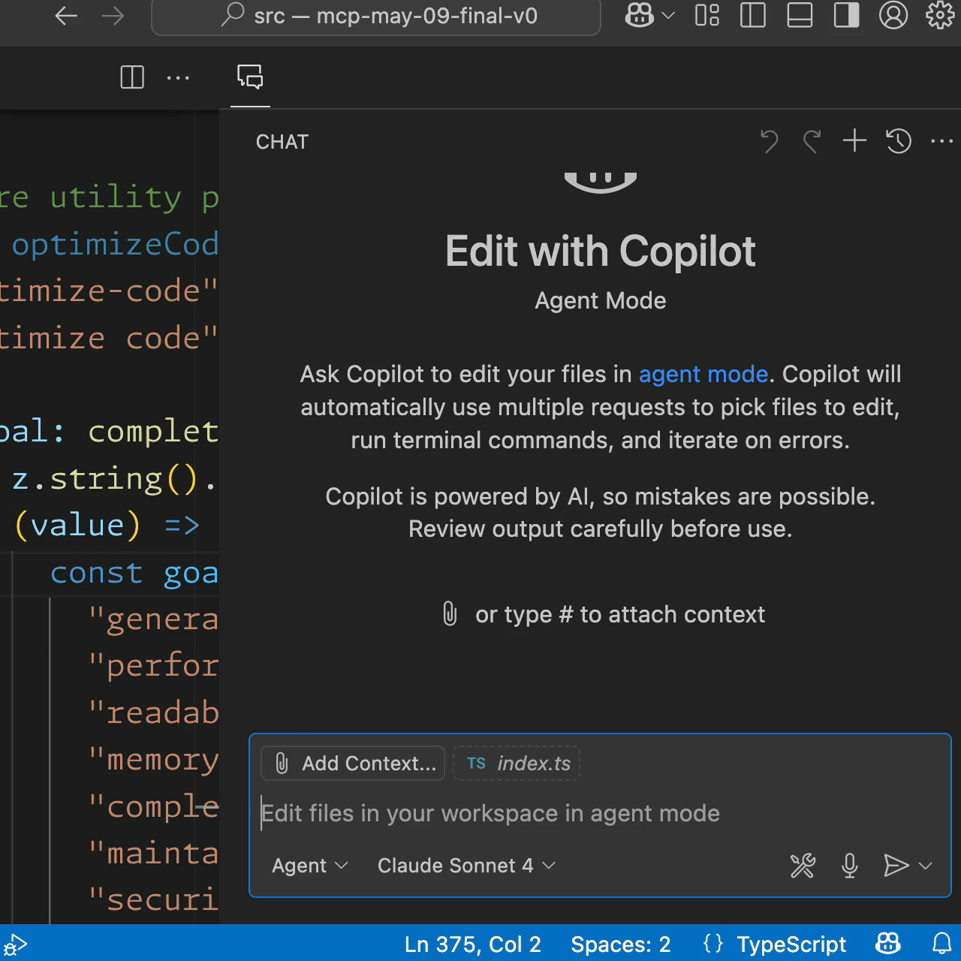
Prompts
Quick
Plantillas predefinidas para tareas de IA, invocadas explícitamente por el usuario.
Ajustes predefinidos estáticos
Reutilizable con marcadores
Generado dinámicamente
Notes:
Prompts allow servers to provide structured messages and instructions for interacting with language models. Clients can discover available prompts, retrieve their contents, and provide arguments to customize them.
Prompts are designed to be user-controlled, meaning they are exposed from servers to clients with the intention of the user being able to explicitly select them for use.
Typically, prompts would be triggered through user-initiated commands in the user interface, which allows users to naturally discover and invoke available prompts.
Here for example I am using the slash command to select a prompt to optize code, then I can fill in information about that prompt and ti will generate a new prompt for me. This is similar to prompts we use in our code base, ut the MCP servers can create and return them.

Slide 17
Prompts: Use cases
From static templates to dynamically generates workflows
Onboarding prompts
Common workflows
Context-aware workflows
Welcome prompts for users to verify setup and tour the tools
One-shot tasks, parameterized for reusability
Dynamically customized for the current user/codebase
Notes:
Prompts can dynamically pull in real-time data, such as GitHub pull request comments
Far more powerful than static templates.

Slide 18
Demo
Prompts, resources, & more!
Notes:
Let’s see it in action

Slide 19
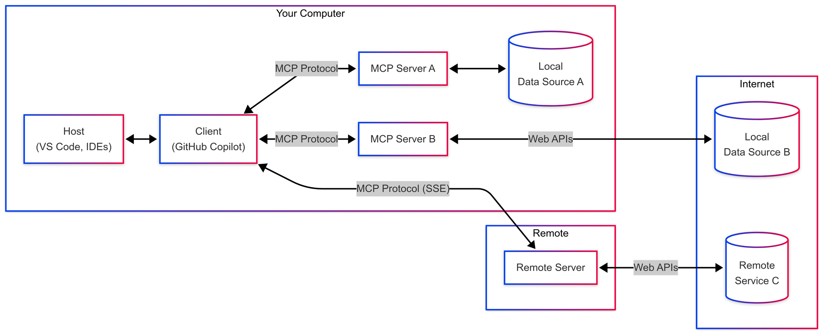

Notes:
We just saw how to setup and use MCP servers, but how and where do they run?
These MCP servers can run on your local machine as an app or inside of a docker container and talk to data sources locally,
or they may be calling web services such as GitHub does to gather or create issues for you.
They can also be executed completely remotely over Server Sent Events or SSE as you may hear it be called.

Slide 20


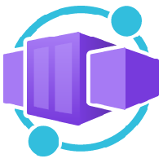


Notes:
These remote servers can be run in Azure Functions, Container Apps, or App Service and be managed by API Management and API Center which are optimized for remote MCP servers.

Slide 21
Building an MCP
aka.ms/letslearnmcp-csharp aka.ms/letslearnmcp-java
aka.ms/letslearnmcp-python
aka.ms/letslearnmcp-javascript
Notes:
[Katie] As mentioned earlier, you can build this yourself, for your company, for developers, or for anyone that may use MCP servers.

Slide 22
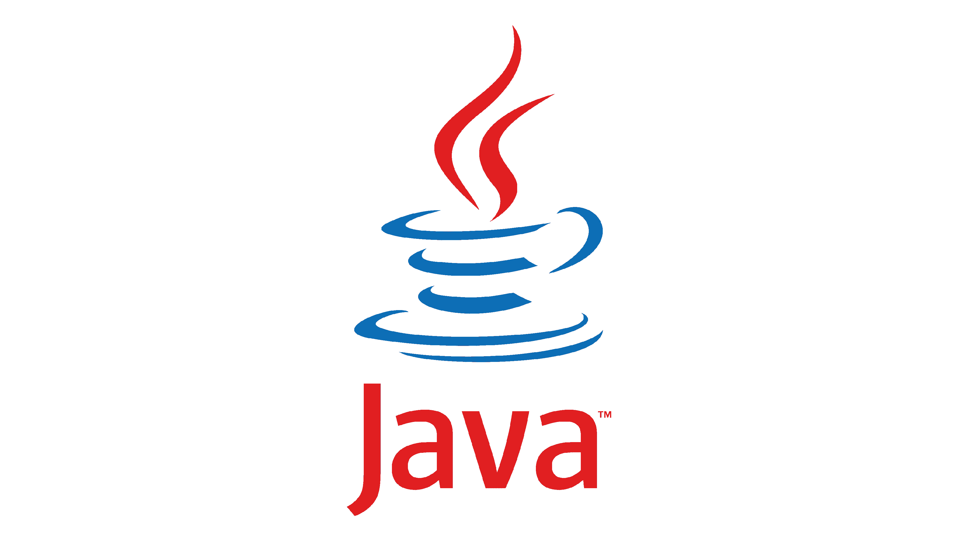

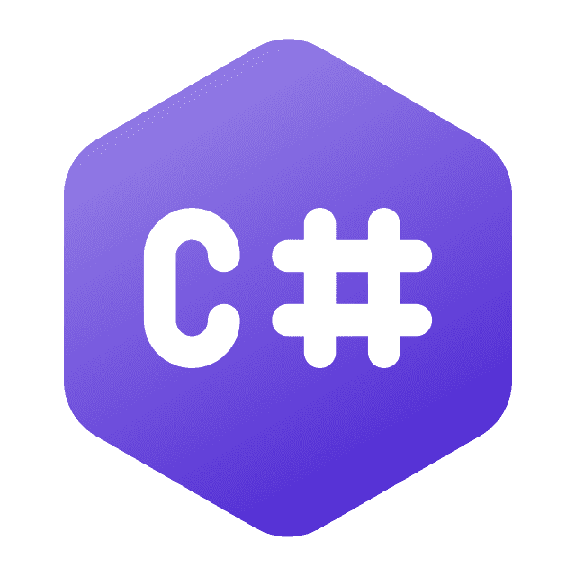
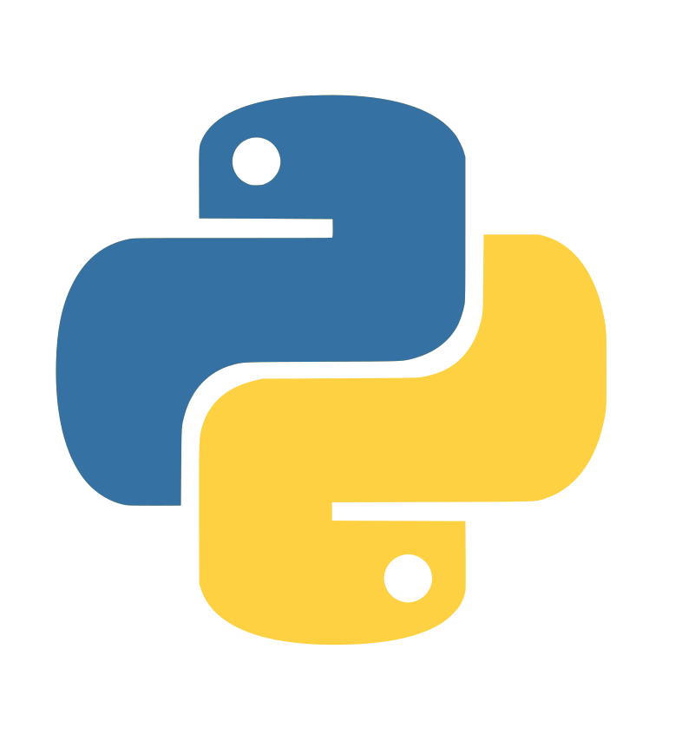

Official SDKs
Notes:
There are SDKs for just about any programming language, and here at Microsoft, we officially maintain the C# SDK

Slide 23
Official C# SDK para MCP
Clientes
Servers
Local – Stdio Transport
Remote – Server Sent Events
Remote – Streamable HTTP
https://aka.ms/csharp-sdk-mcp
Notes:
With the C# SDK you can actually build and integrate client functionality into your apps so they can communicate with MCP server directly.
And of course you can also build MCP servers using any of the different transports out there. That is what we are going to do today.

Slide 24
NuGet Packages
ModelContextProtocol.Core
ModelContextProtocol
ModelContextProtocol.AspNetCore
Notes:
There are 3 main NuGet Packages. There is a core base that the main MCP package uses. ModelContextProtocol package will be the one that we use today and provides access to STDIO out of the box. The AspNetCore package builds on top of this and supplies support for HTTP transports with MCPs.

Slide 25
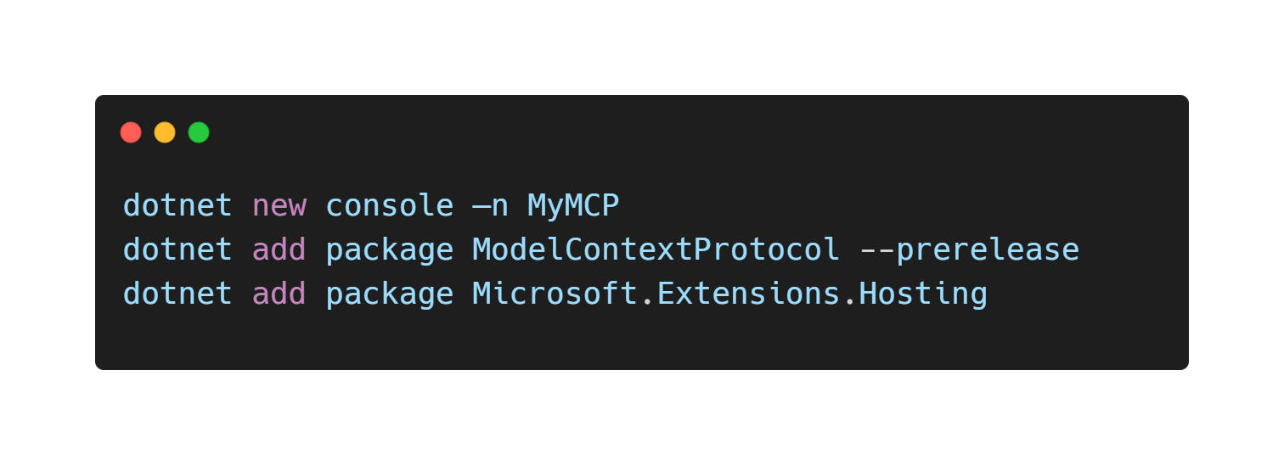
Get Started
Notes:
[James]
To get started it is as easy as creating a new console app and adding in the NuGet packages we need.

Slide 26
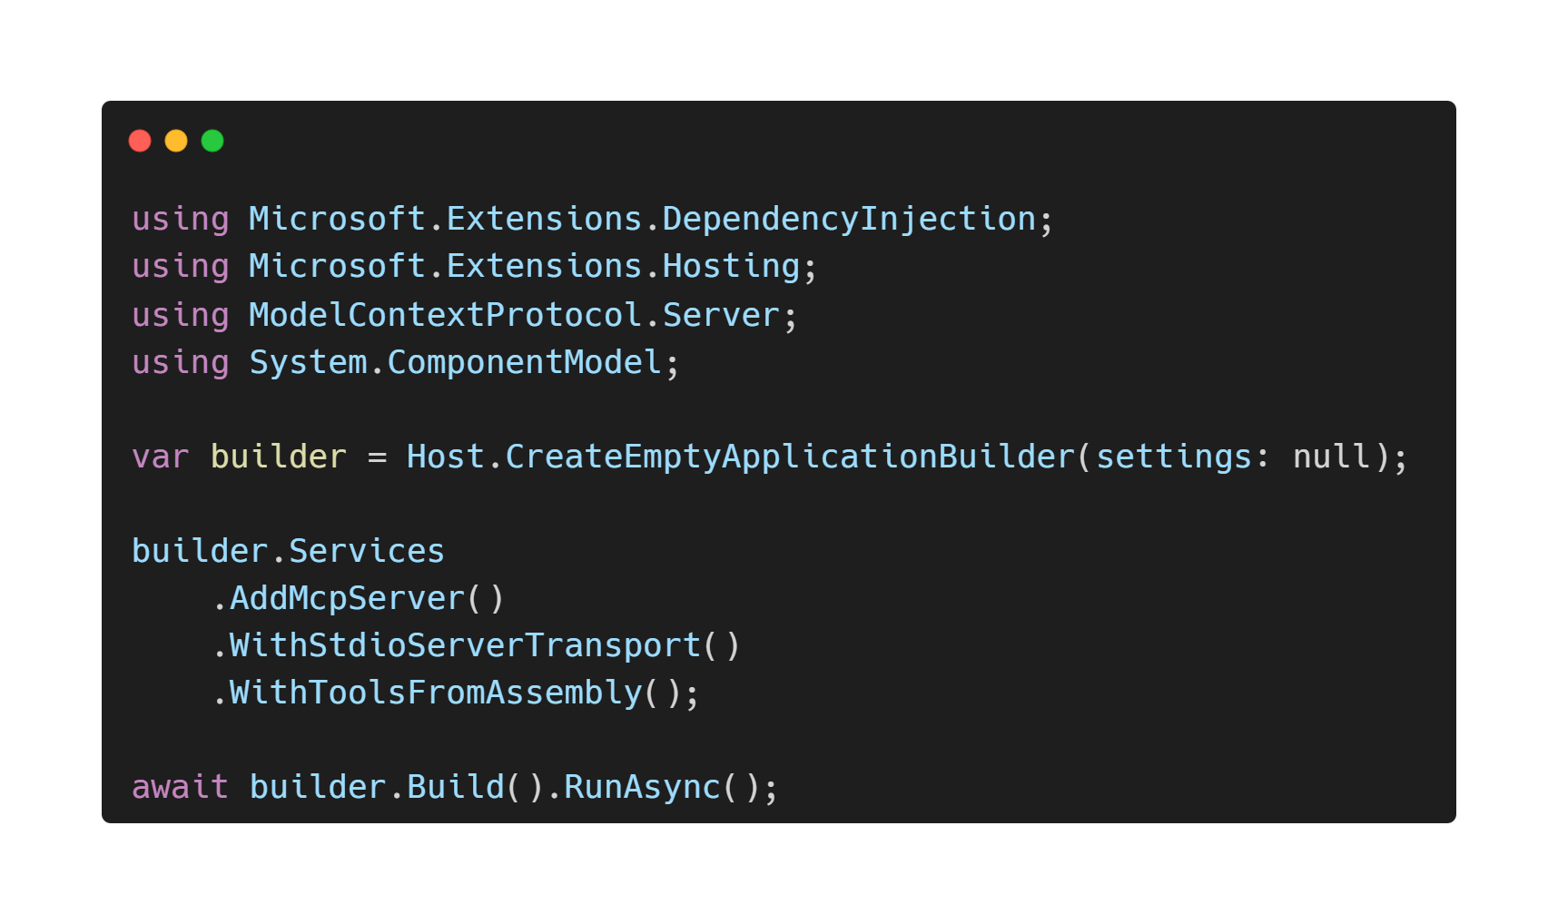
Notes:
Bring in our namespaces and scaffold out our main setup code for our server tools and any dependencies we may have.

Slide 27
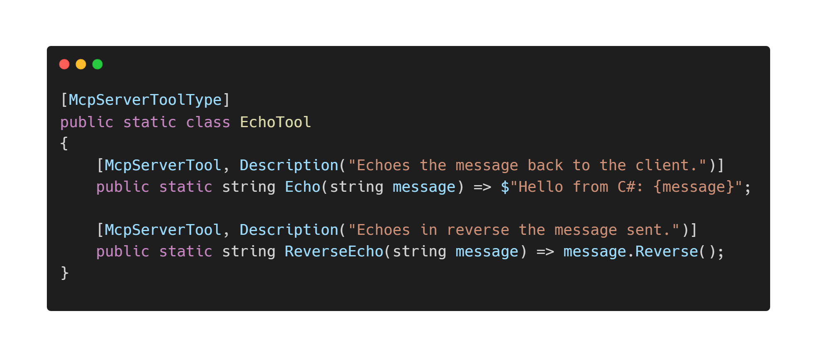
Notes:
Finally are the tools themselves. We mark the class as a ToolType to give indication that there are Tools available and then put the attribute of Tool on each of them that will be exposed.

Slide 28
Demo
Building an MCP Server
Notes:
Alright, let’s build one!

Slide 29
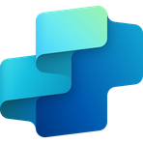
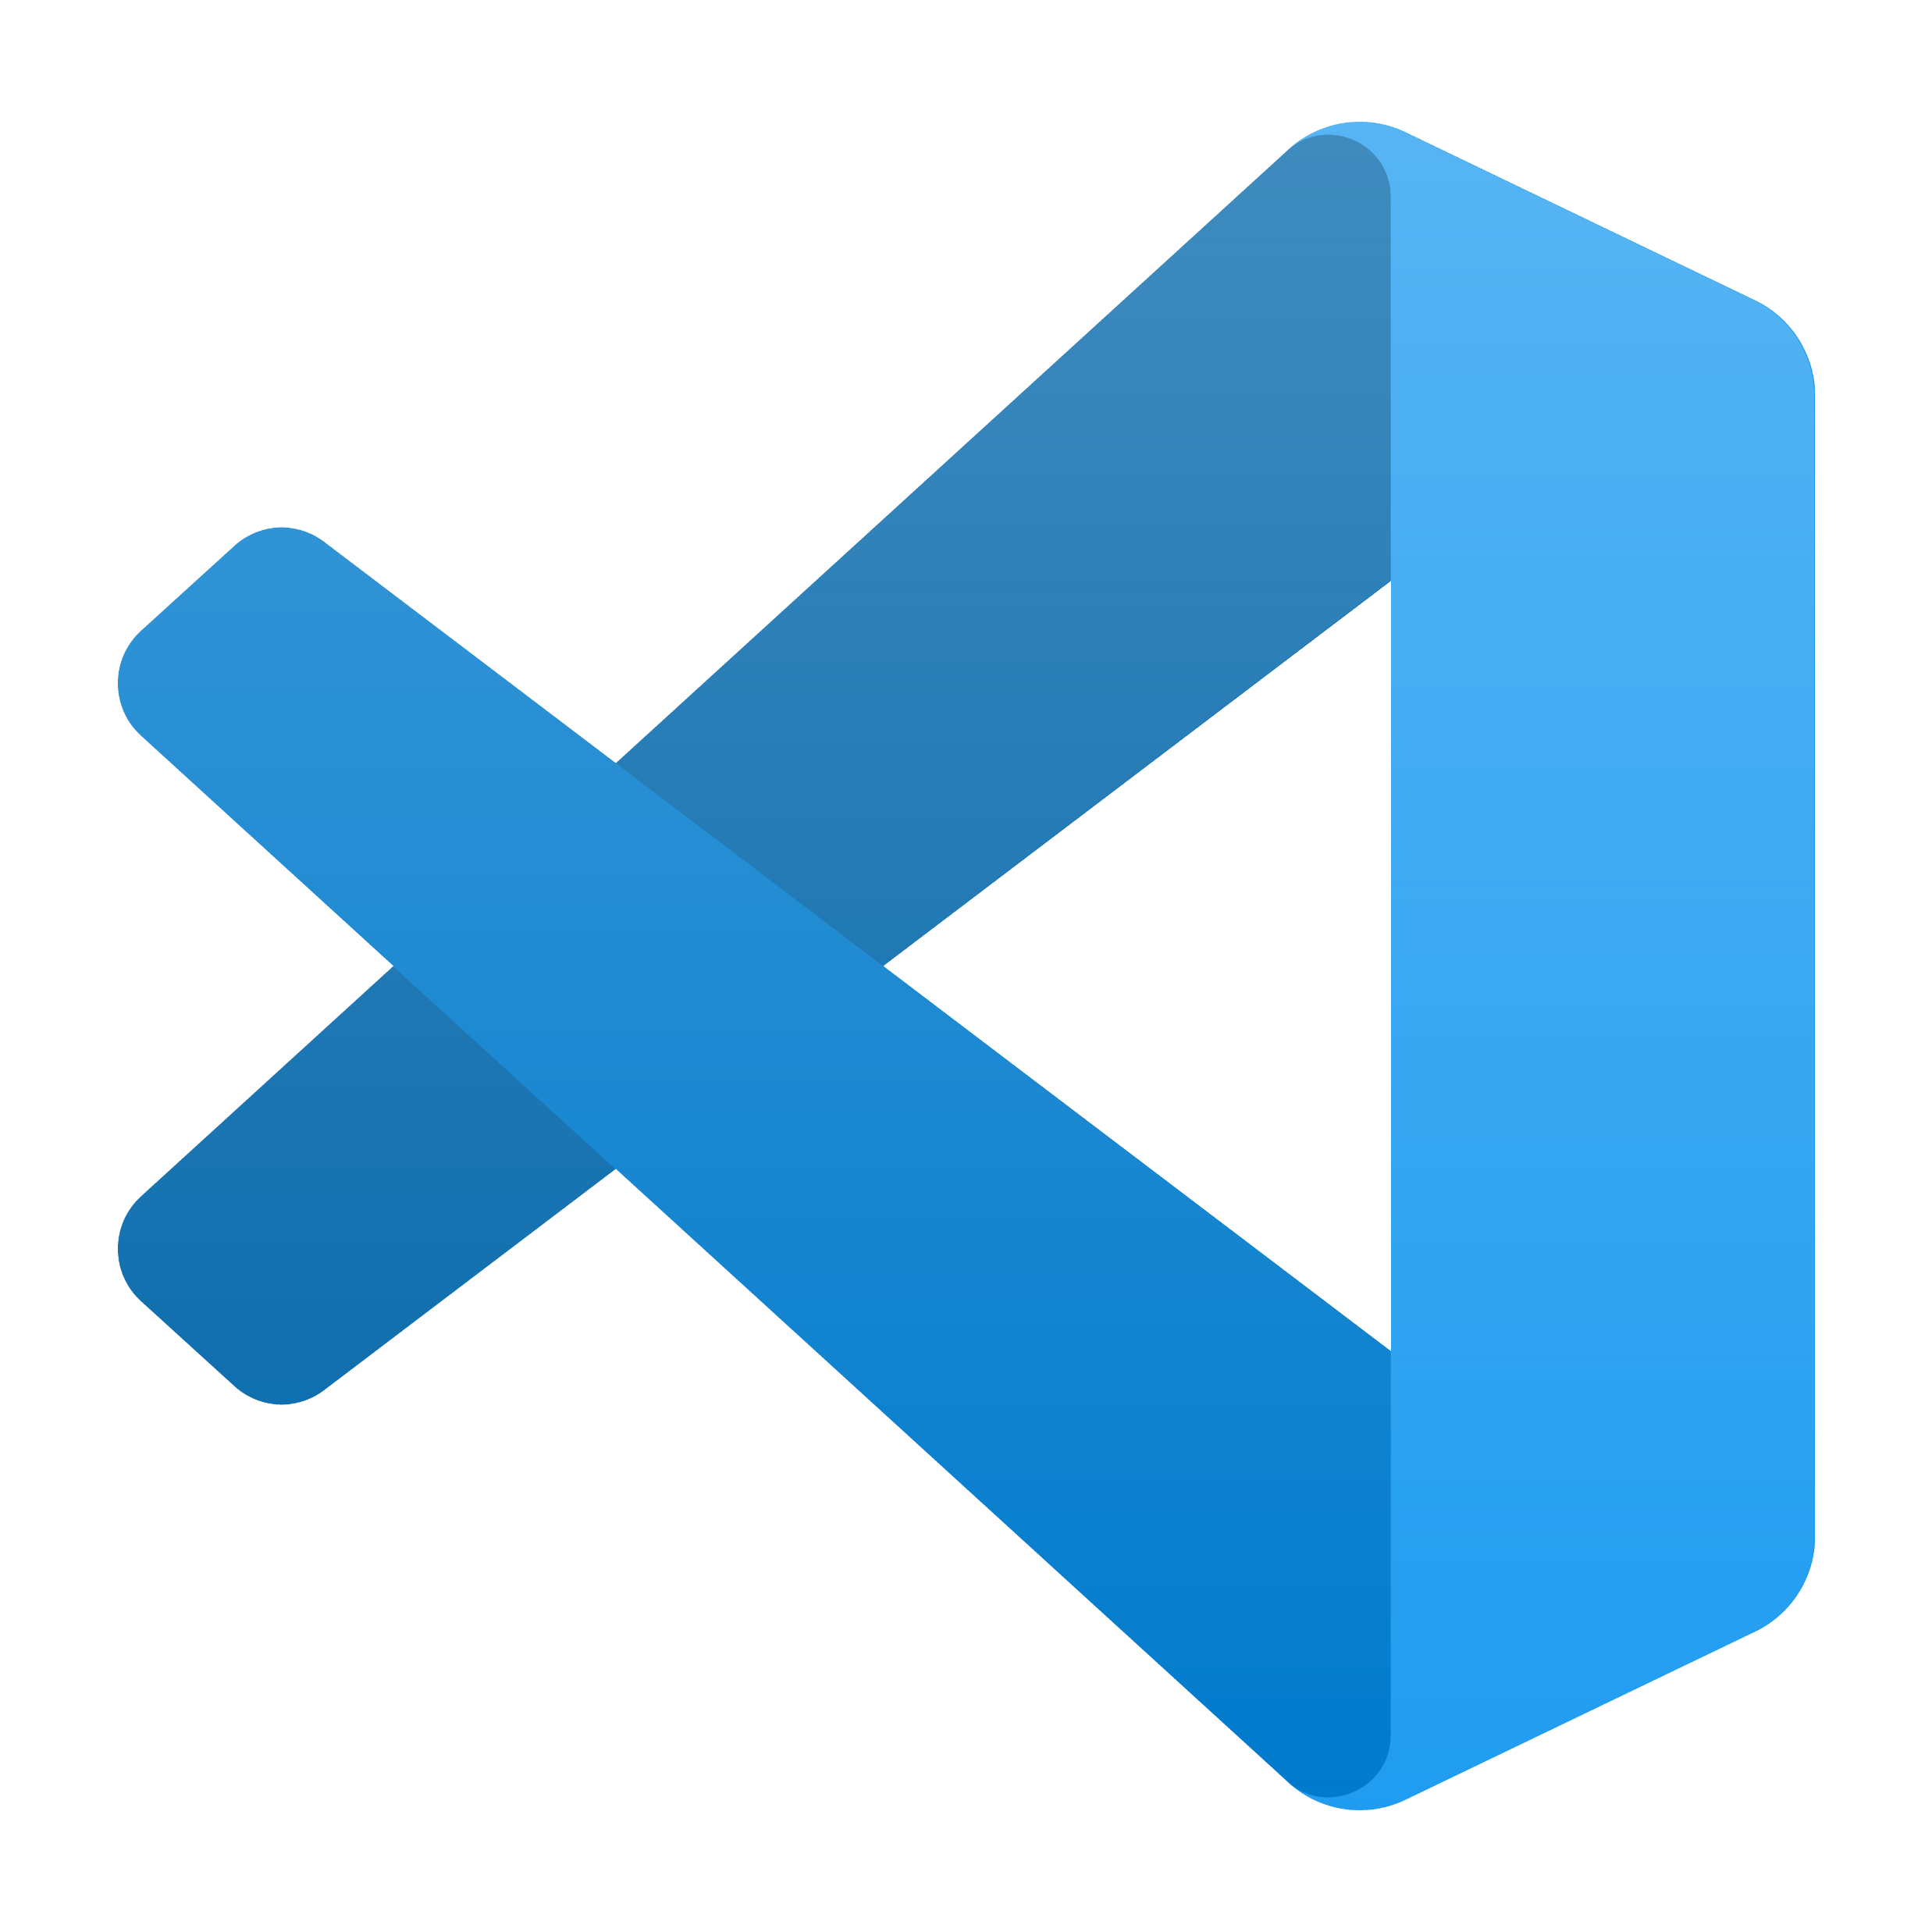

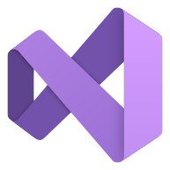






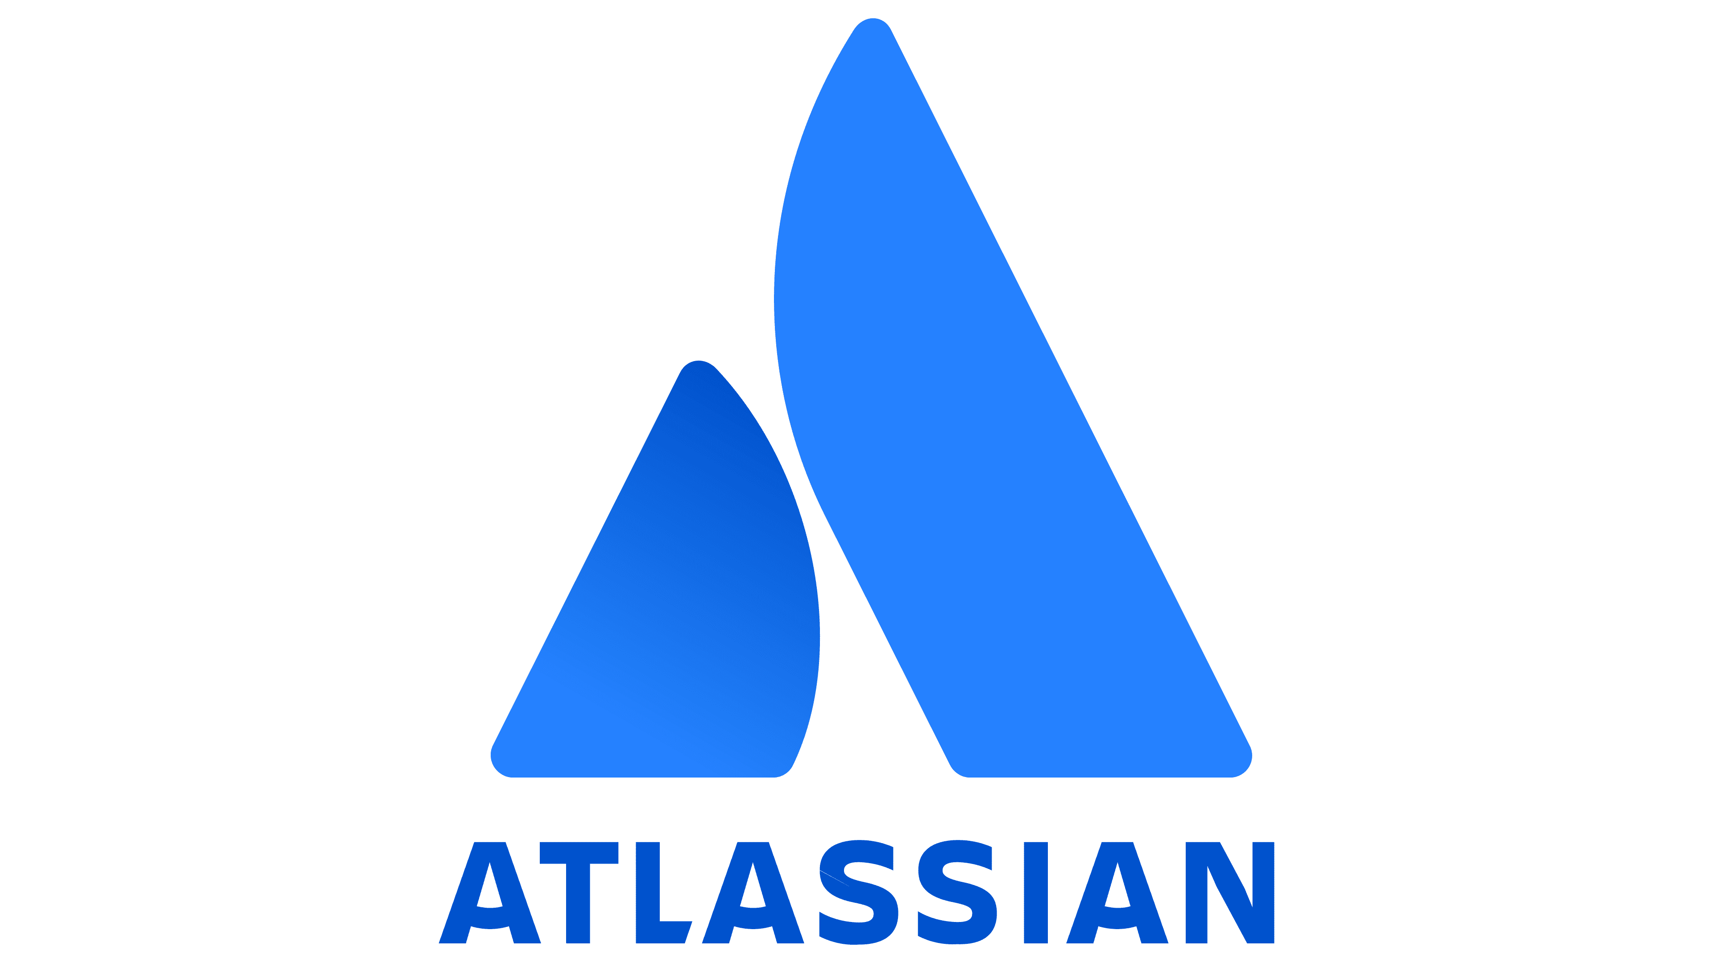
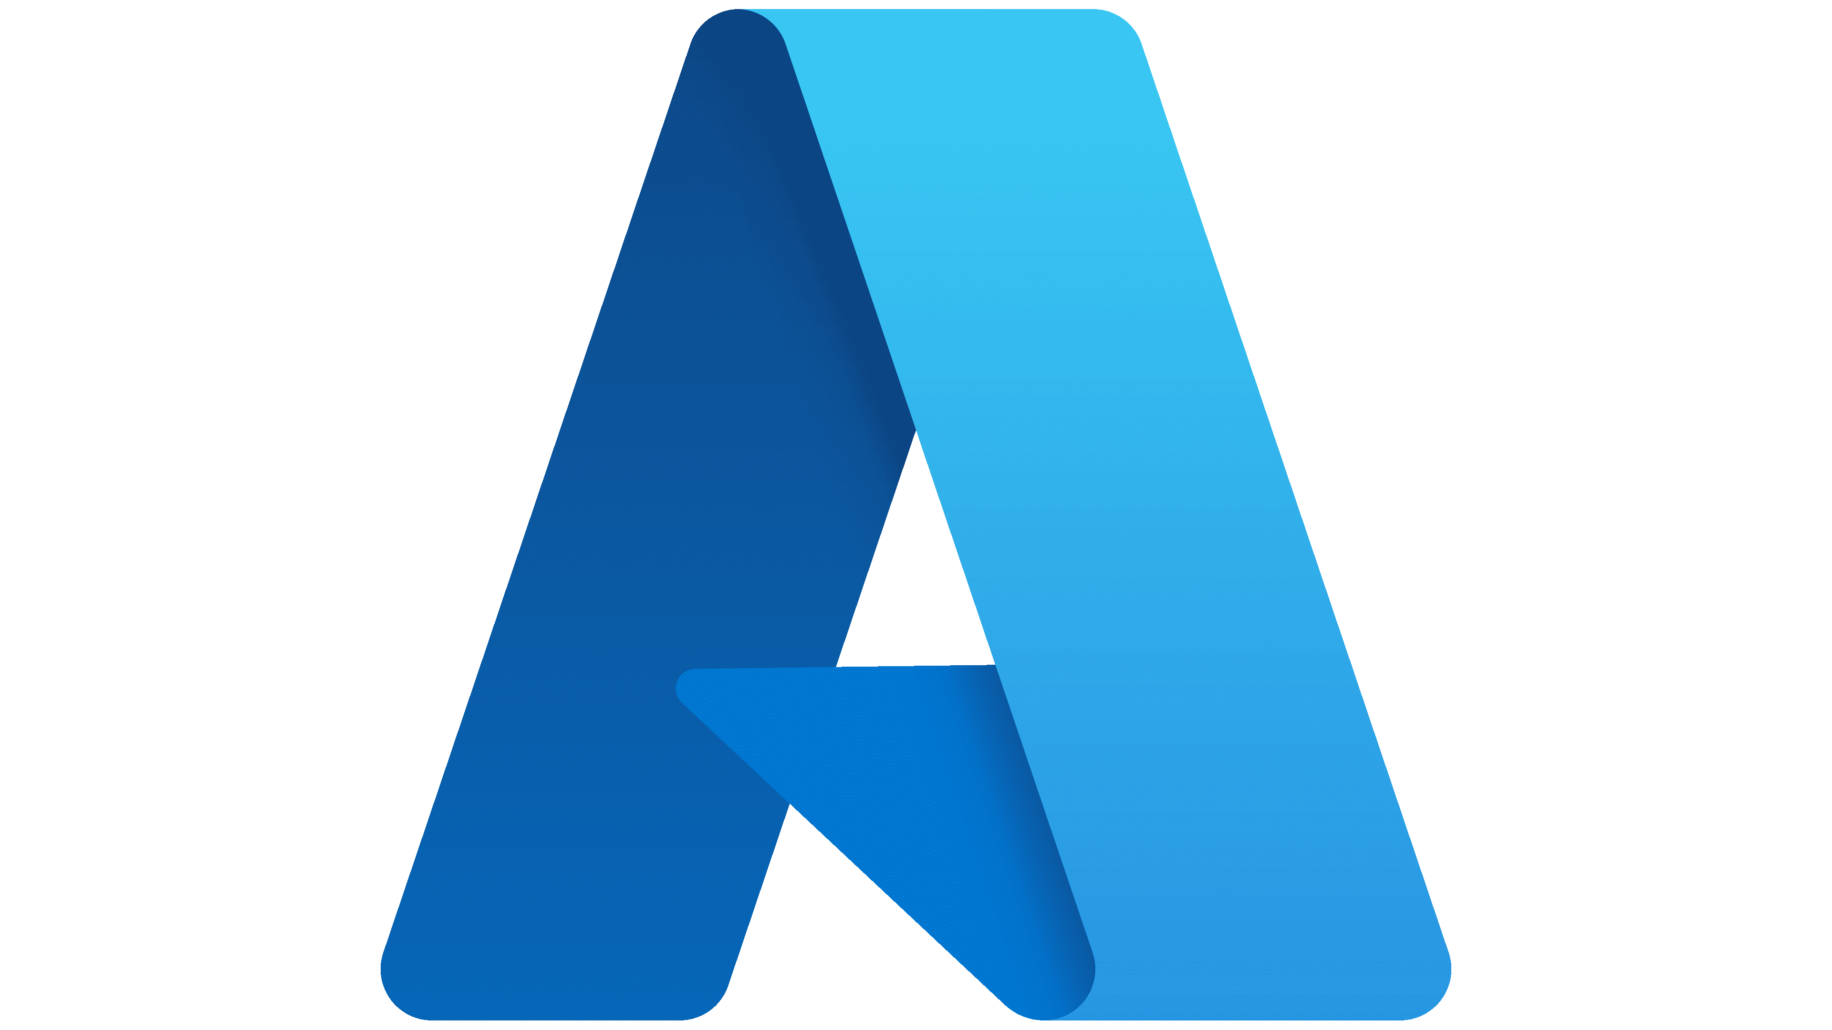
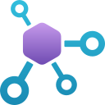






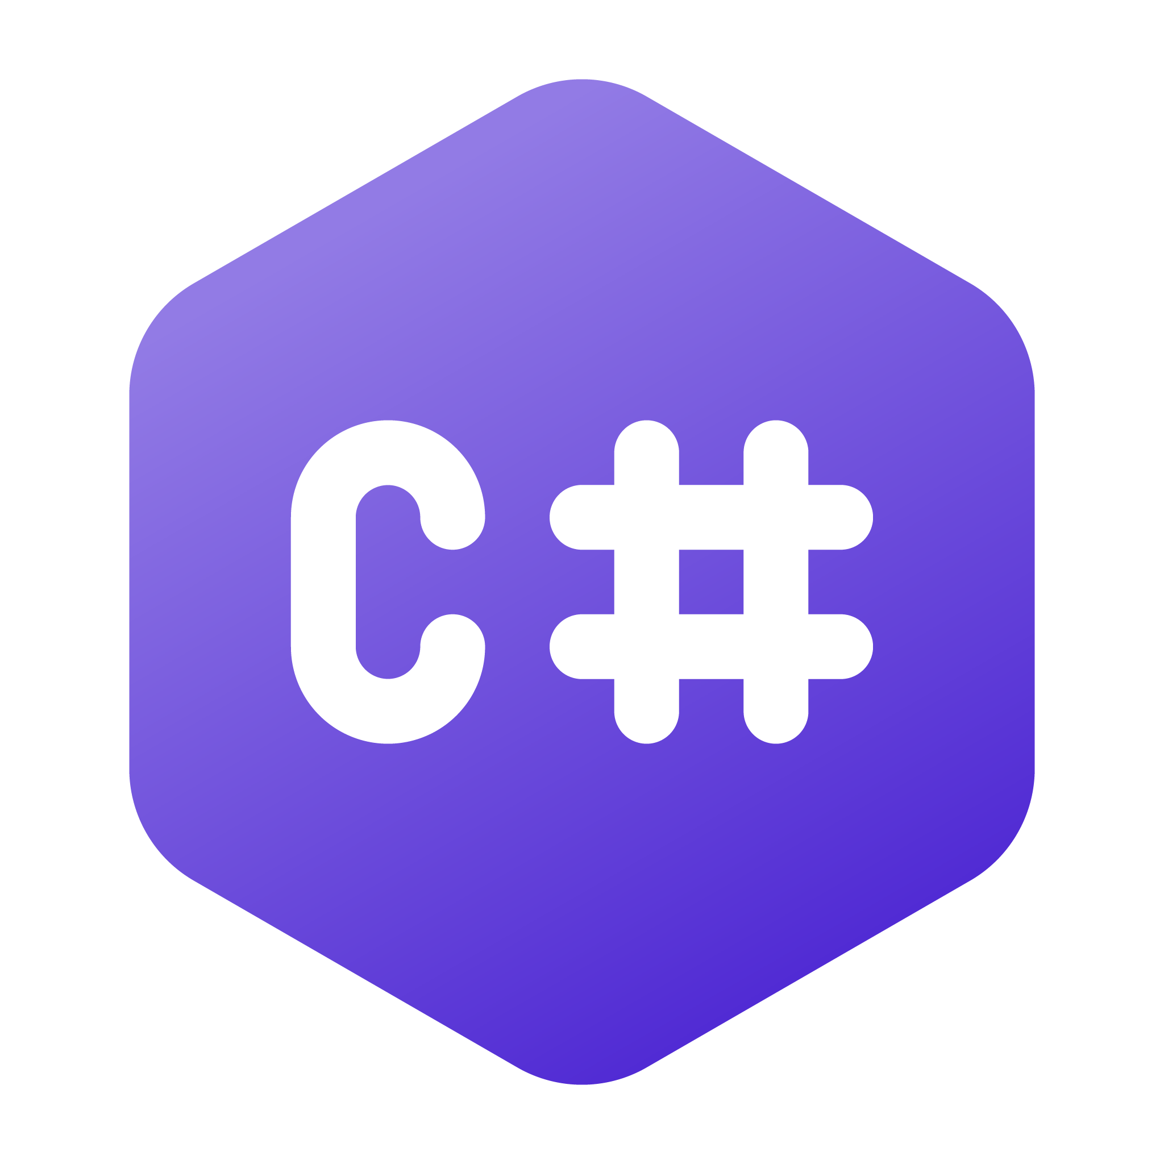
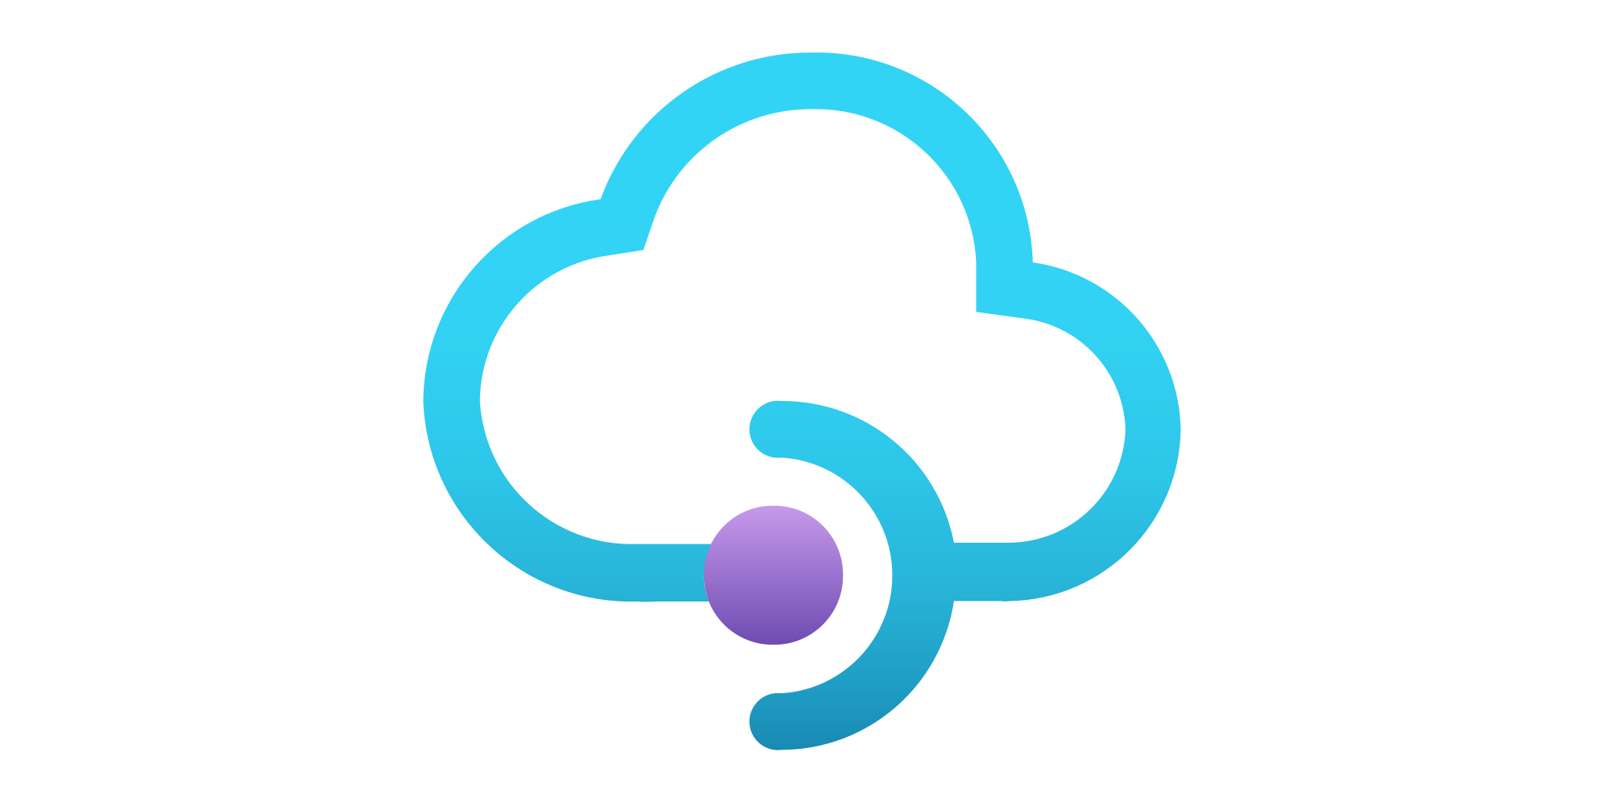

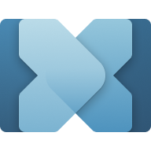

Model Context Protocol At Microsoft
Copilot Studio
VS Code
Foundry Agent
Visual Studio
Windows
GitHub Copilot
Microsoft Teams
Semantic Kernel
MCP Clients & Host
Community
Enterprise
Windows
Tools
Registry
C# MCP SDK
Azure API Management
Azure Functions
Microsoft Connectors
Build Local & Remote MCPs
MPC enables seamless Integration between LLM Apps and external data sources
Model Context Protocol
Notes:
Value Proposition of MCP: At Microsoft, we are all in on MCP. The Model Context Protocol has revolutionized our Agentic workflows, accelerating them faster than anything we have seen before. MCP seamlessly enables integration between intelligent applications and external data sources, providing a robust framework for creating dynamic and responsive solutions.
Building Local and Remote MCPs: Whether you are building local or remote MCPs, Microsoft is here to support you. We have collaborated with Anthropic and the .NET community to develop the official C# SDK, opening up the possibilities of MCPs to our millions of .NET developers. With Azure API Management and Azure Functions, we make it easy to build secure remote MCPs, ensuring that your solutions are both scalable and secure.
MCP Tools Accelerate Productivity: MCP tools are designed to accelerate productivity for your Agentic workflows. Whether you are a consumer or a developer, Microsoft is fully invested in MCP. We have launched several flagship MCPs across Azure, GitHub, and Windows. In collaboration with Anthropic, we are fostering an MCP ecosystem that is discoverable through a community registry on GitHub. Additionally, we offer a private, secure registry with Azure API Center and tools on Windows to manage MCPs across your devices.
Delivering Productivity Across Microsoft Applications: MCPs are delivering significant productivity gains across various Microsoft applications. From Azure to GitHub and Windows, MCPs are integrated into our core platforms, enhancing the capabilities and efficiency of our intelligent applications.
Conclusion: In summary, Microsoft's commitment to MCP and our collaboration with Anthropic is driving the growth and evolution of this protocol. We are dedicated to providing the tools and support needed to build and deploy MCPs, ensuring that our developers and users can harness the full potential of this transformative technology.

Slide 30
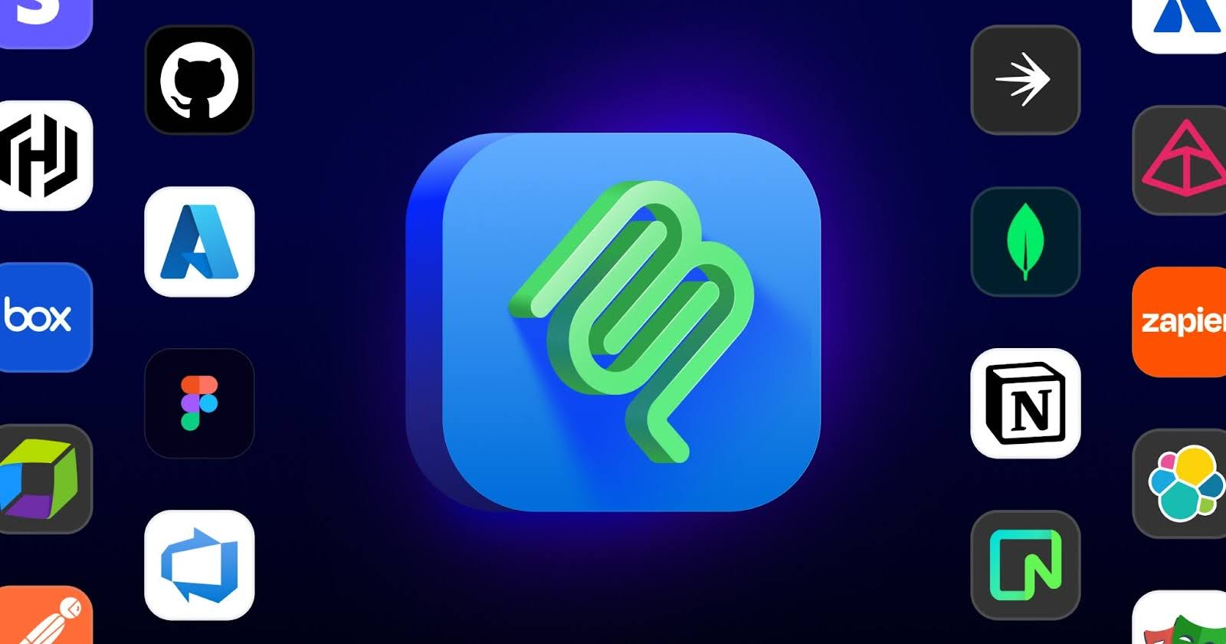
GitHub MCP Registry
Servidores y herramientas de la comunidad que conectan modelos con archivos, APIs, bases de datos y más..
Lanzado en septiembre 2025
Detectable dentro de VS Code, instalaciones con un solo clic
Funciona con cualquier host compatible con MCP (incluido GitHub Copilot)
Destinado a reducir la duplicación y aumentar la confianza al elegir y usar servidores MCP.
github.com/mcp

Slide 31
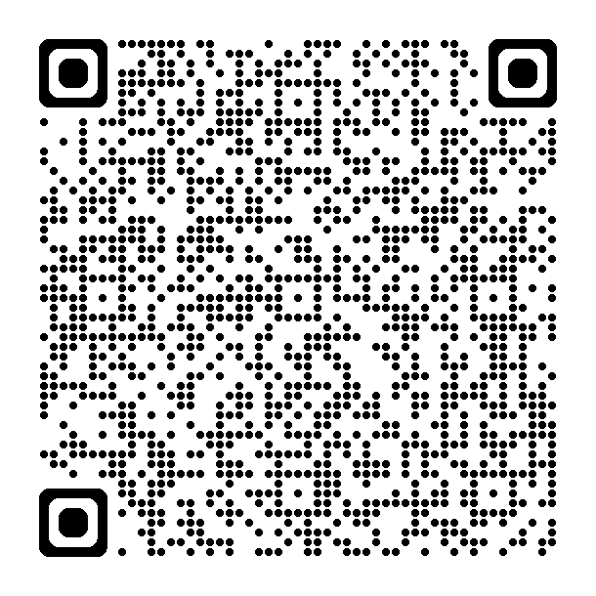
SPEAKERS: Update tutorial link for your programming language
Learn more
Microsoft wants to hear from you!
Participate in the Season of AI post-event survey to share your feedback on this topic and content.
Today's tutorial
aka.ms/letslearnmcp-csharp
More training
aka.ms/mcp-for-beginners
VS Code MCP Support
aka.ms/vscode-mcp
Model Context Protocol
modelcontextprotocol.io
Online AI Community
aka.ms/AIDiscord
https://aka.ms/soai/mcp/attendeesurvey

